Slide 1




Slide 2
FLOOR PLANS

Slide 3
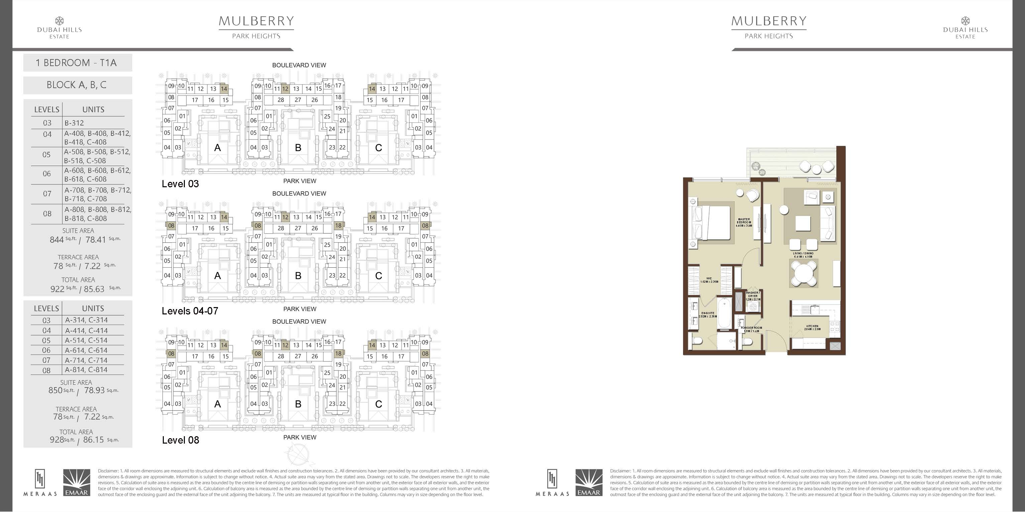



1 BEDROOM (TYP.01)

Slide 4
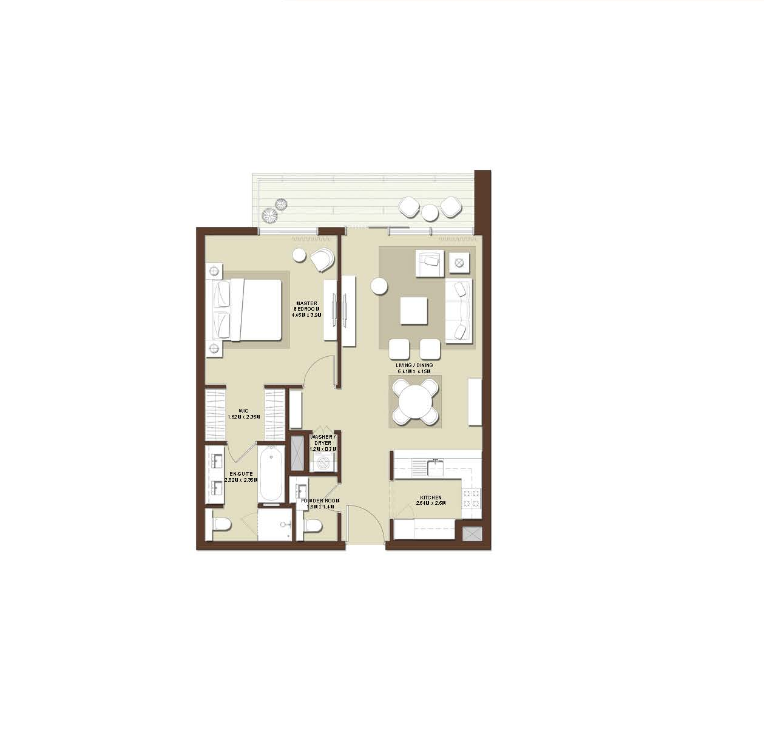
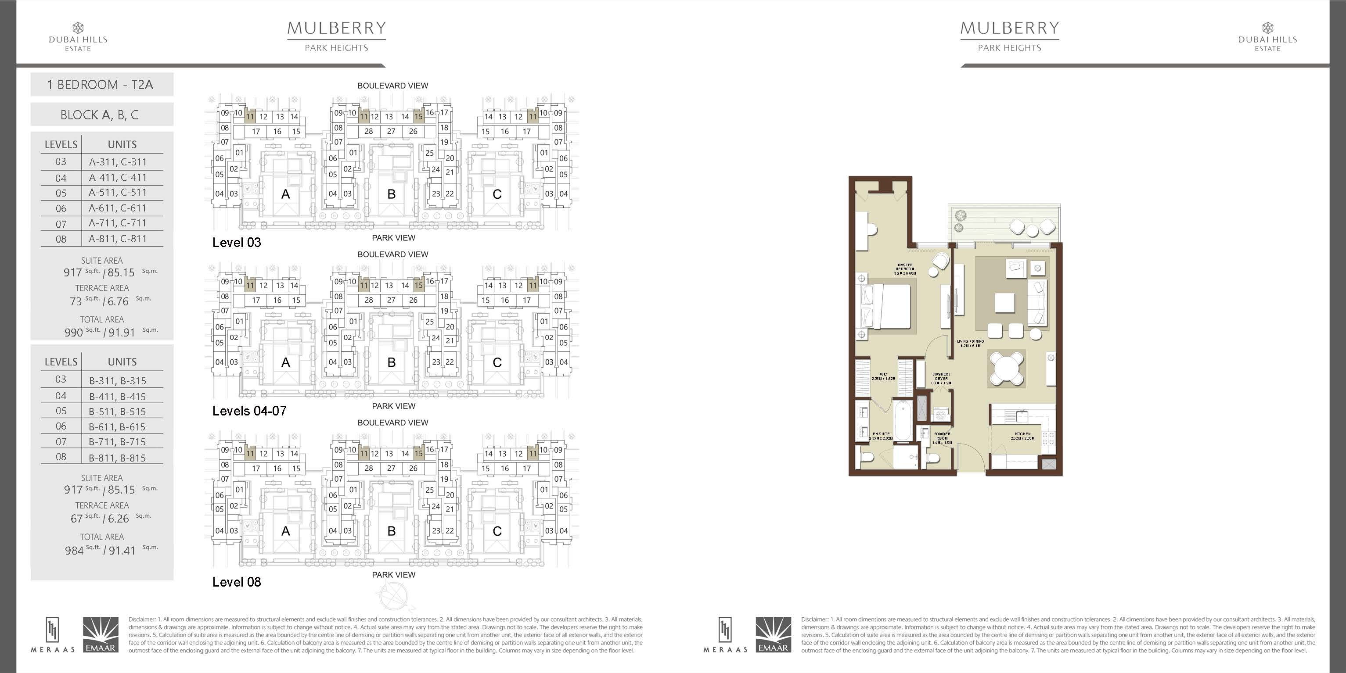
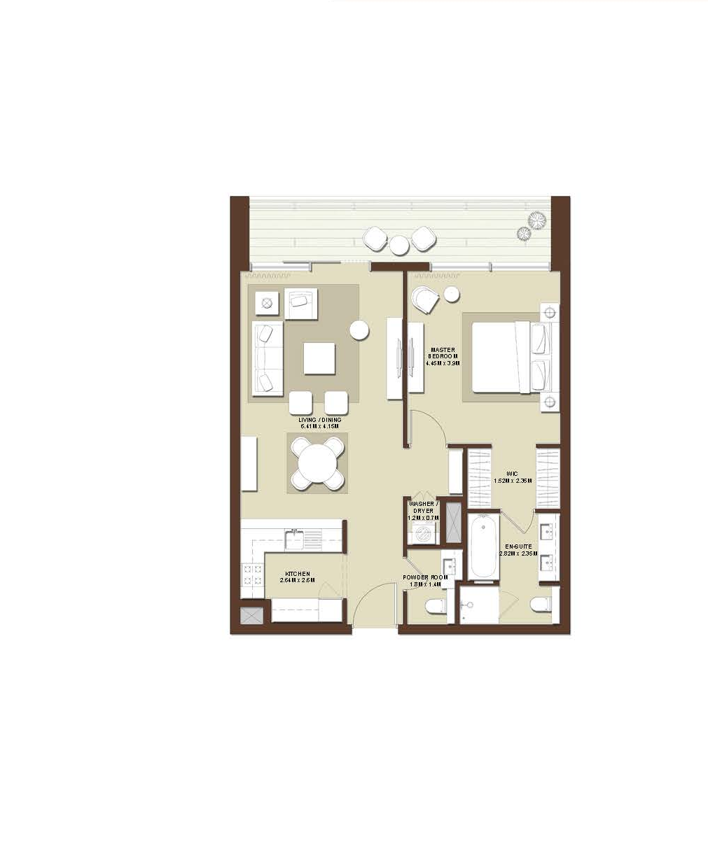
1 BEDROOM (TYP.02)

Slide 5
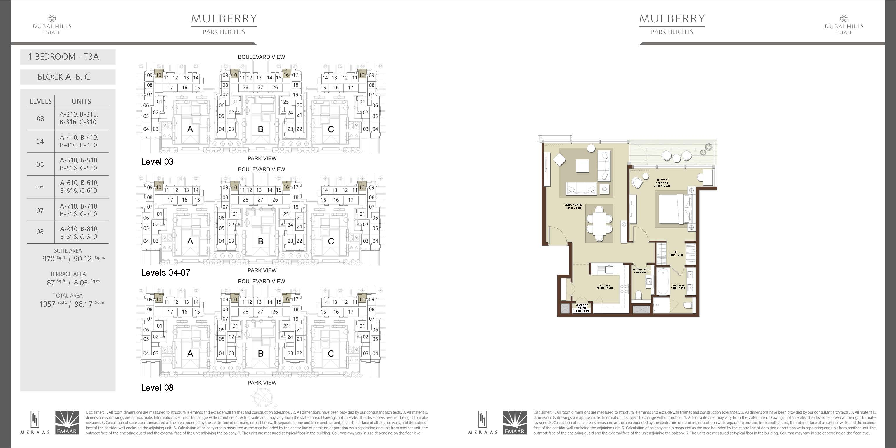
1 BEDROOM (TYP.03)

Slide 6
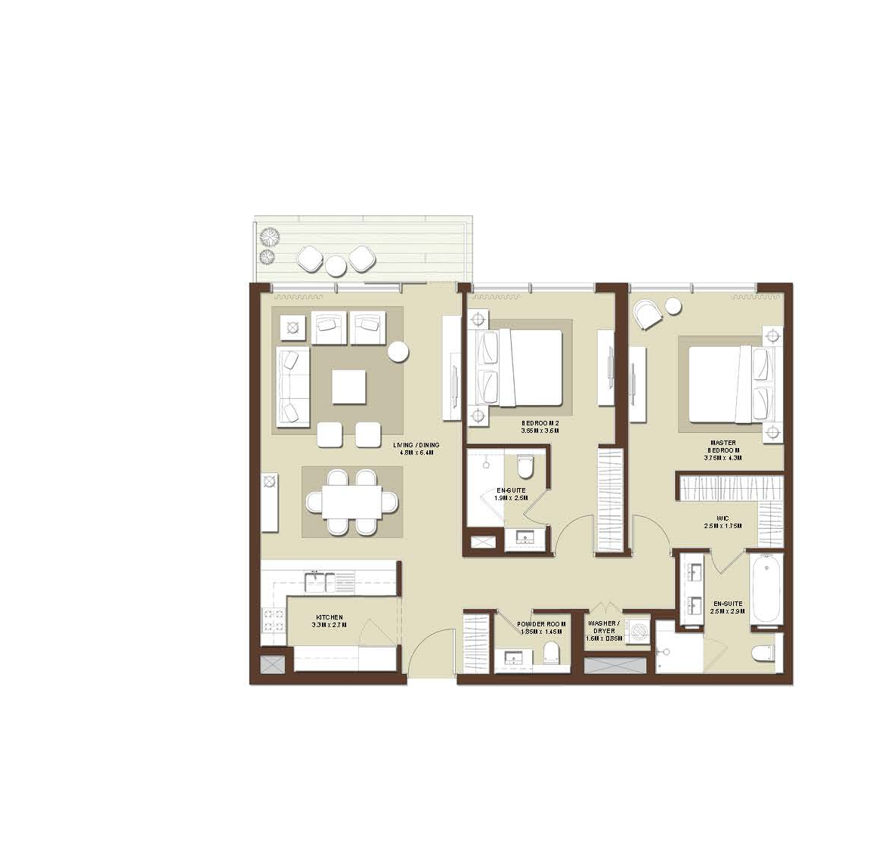
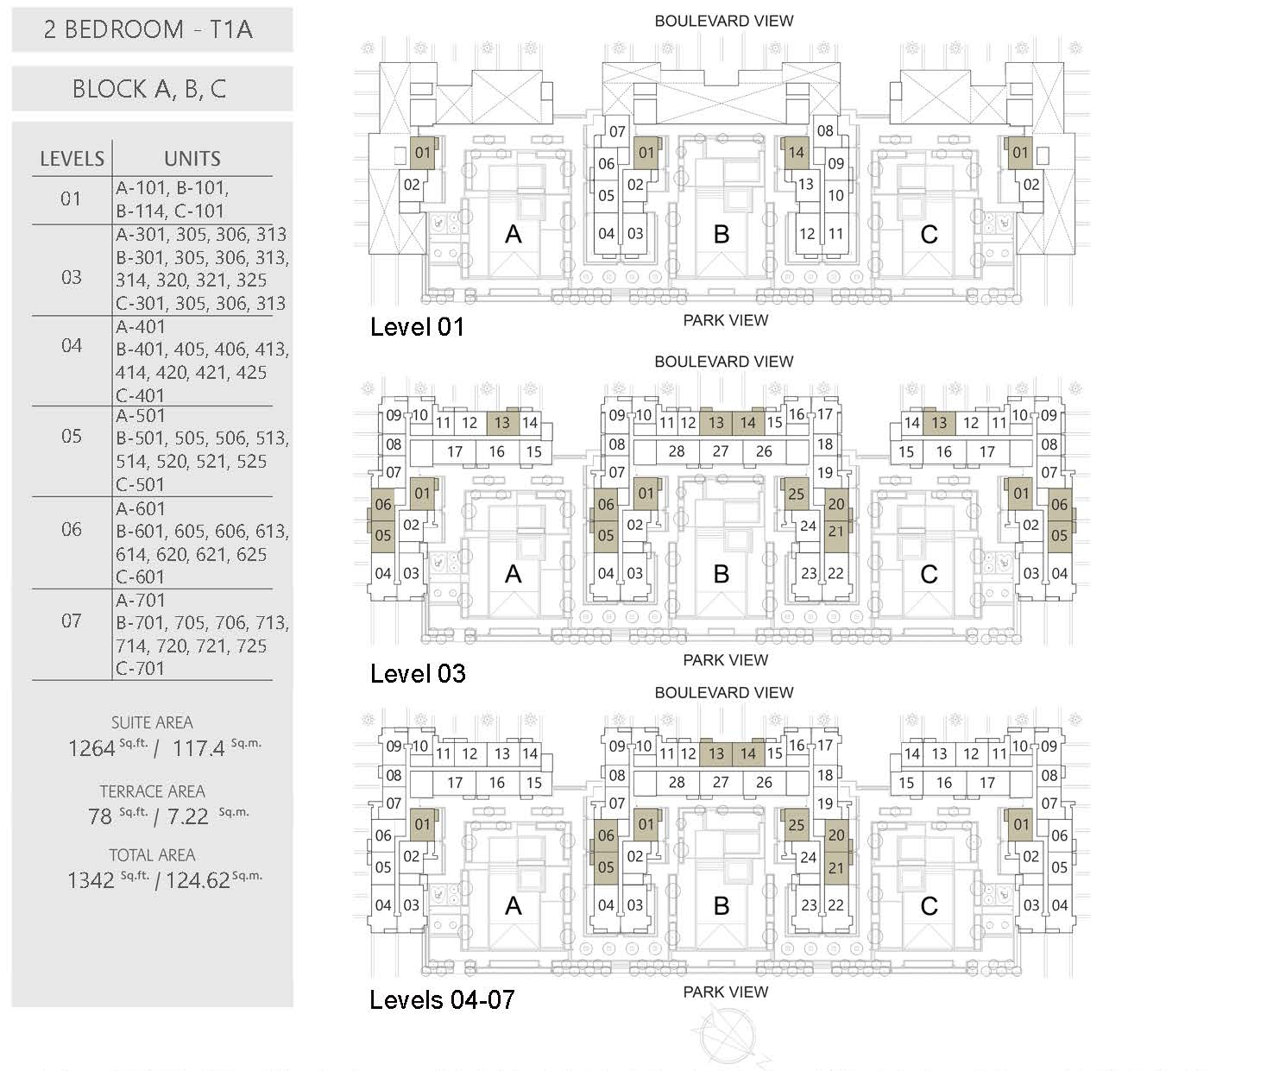
2 BEDROOM (TYP.01)

Slide 7
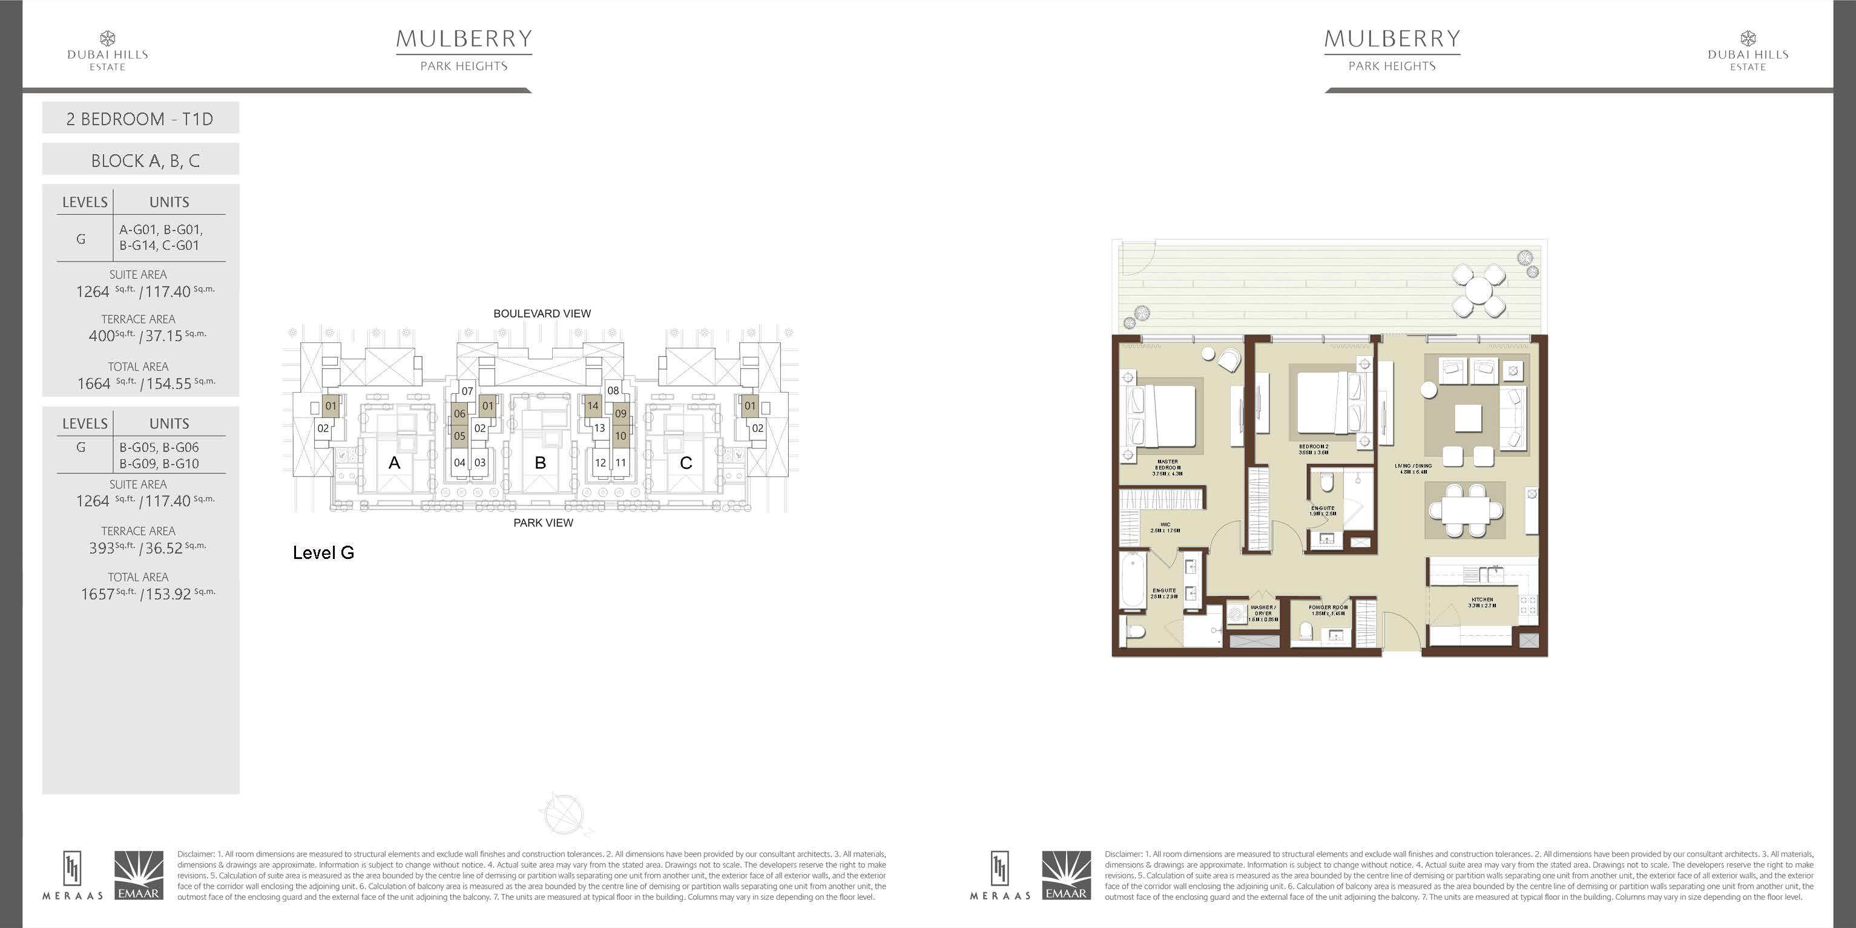
2 BEDROOM (TYP.01 G LEVEL)

Slide 8
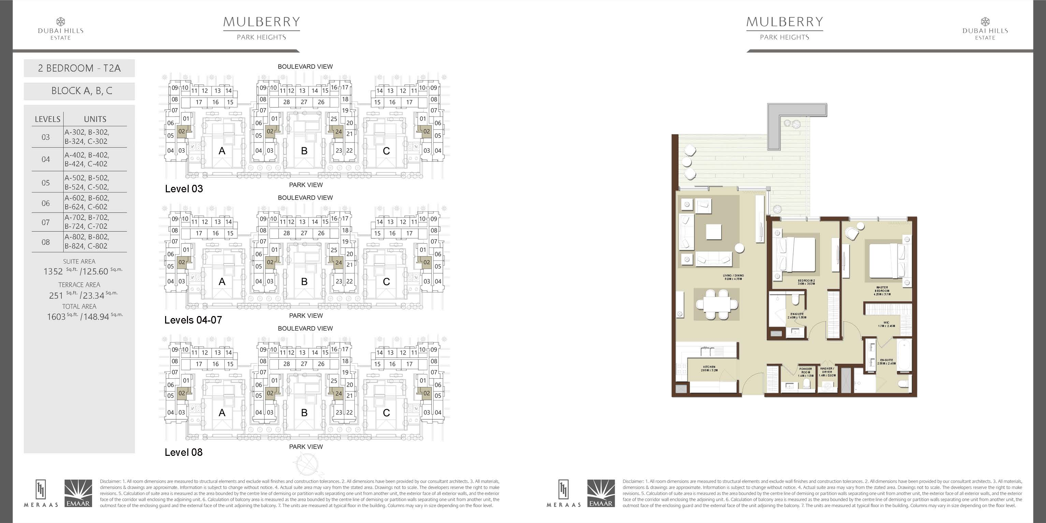
2 BEDROOM (TYP.02)

Slide 9
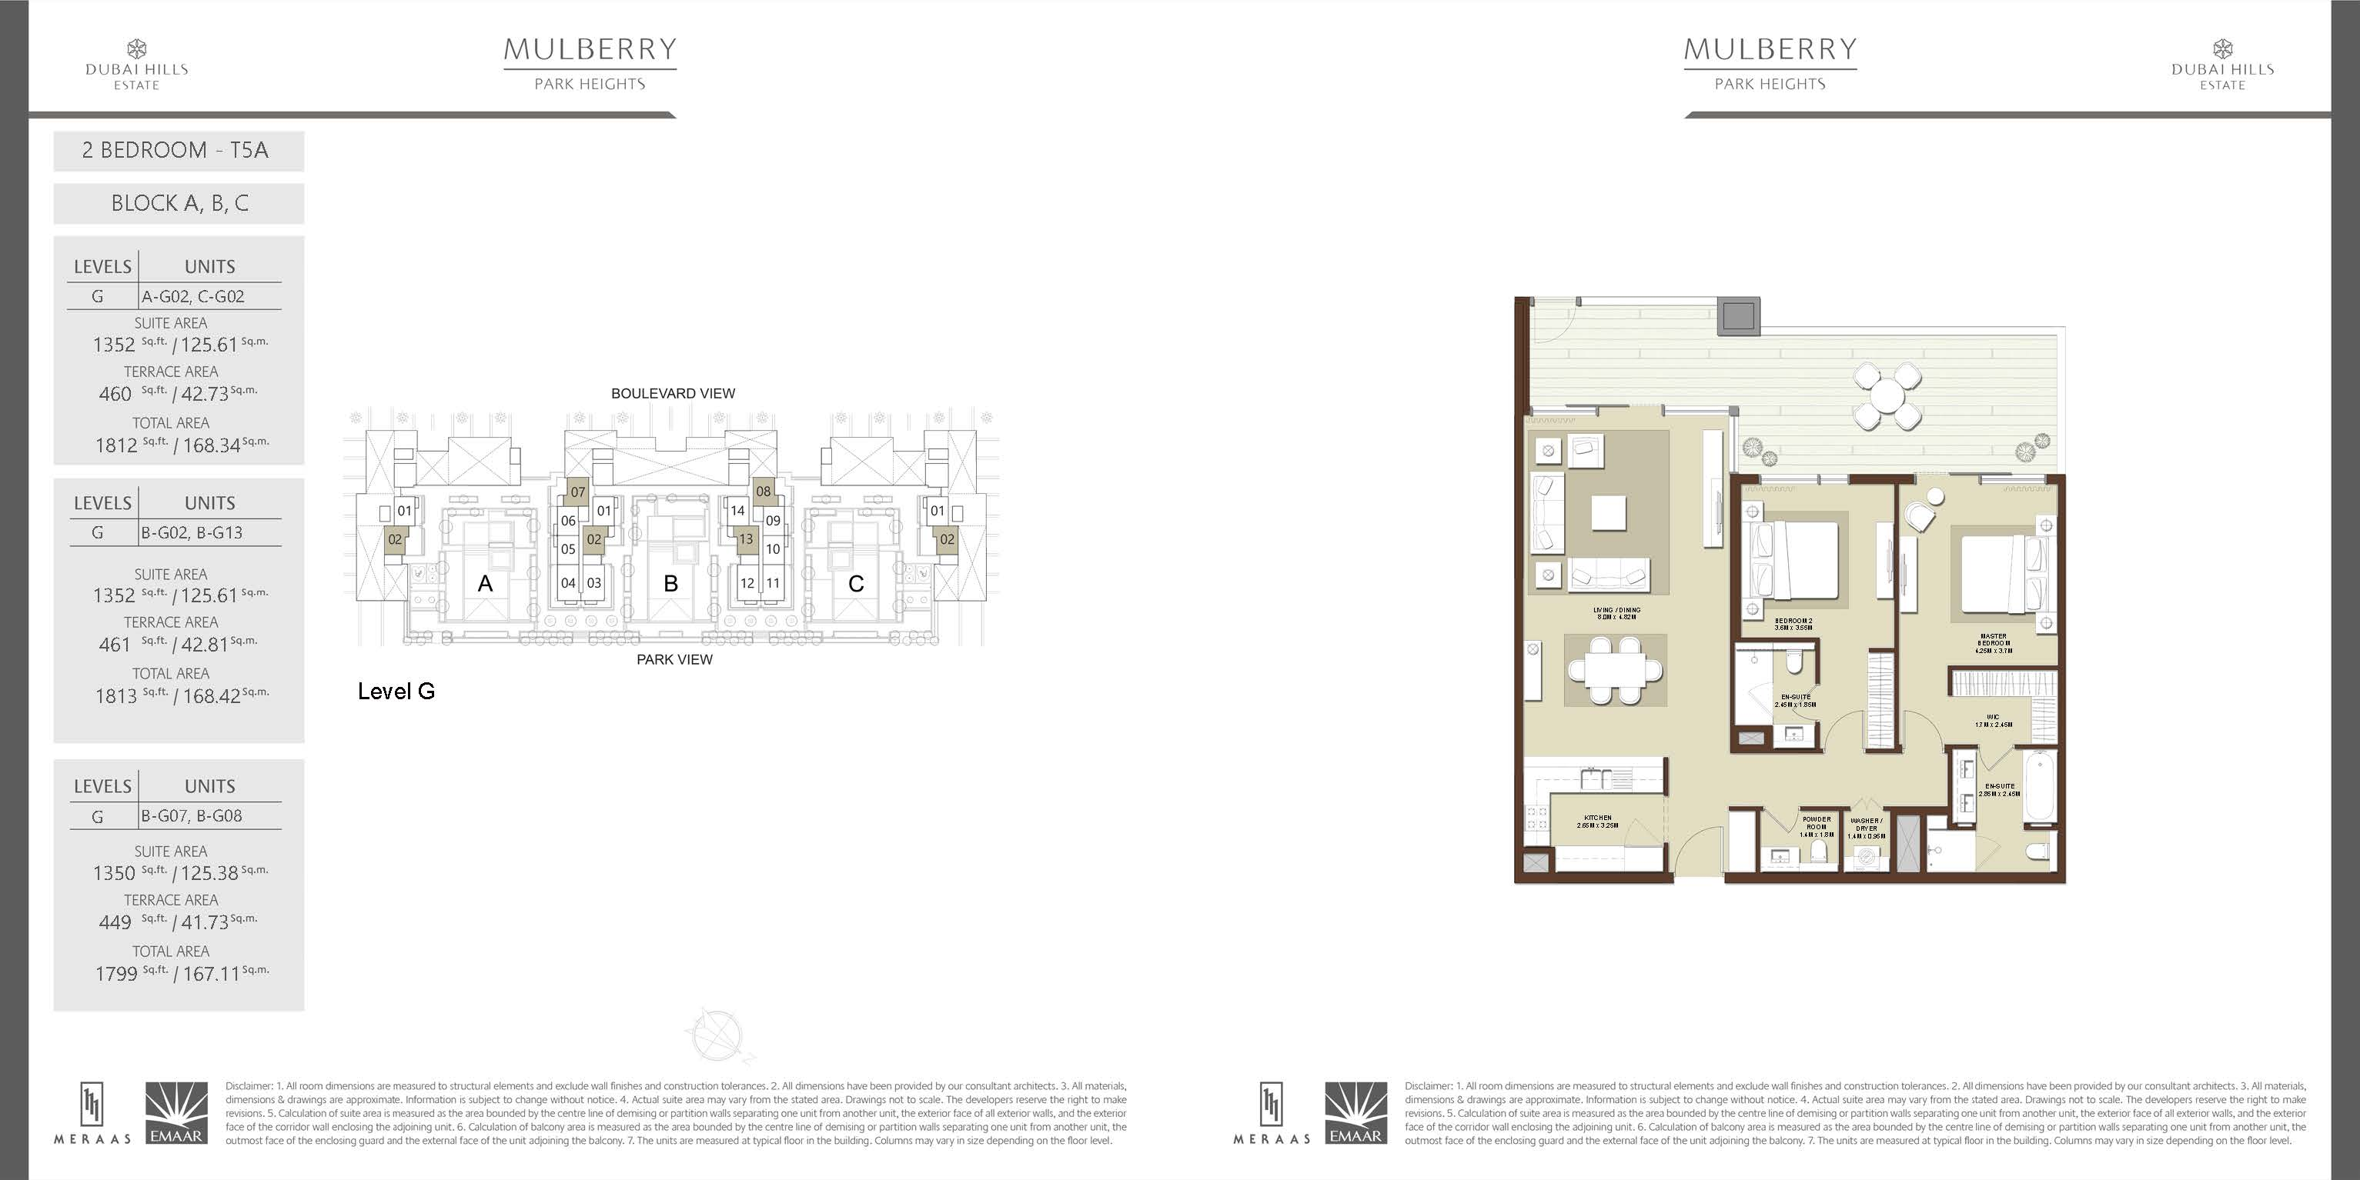
2 BEDROOM (TYP.02 G LEVEL)

Slide 10
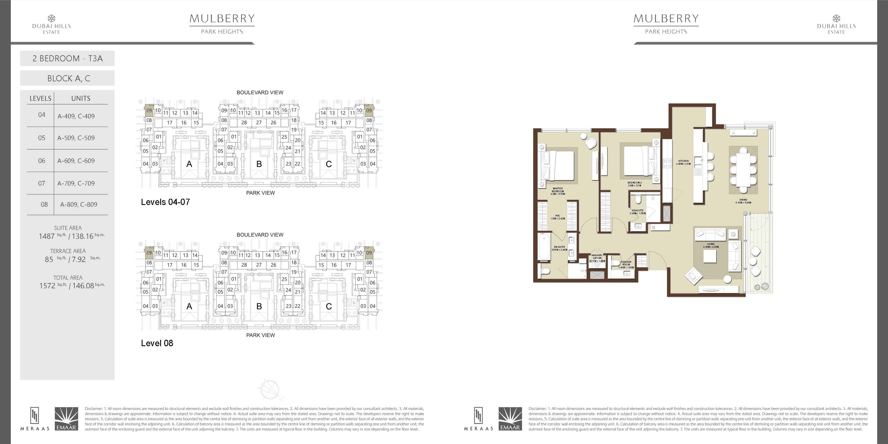
2 BEDROOM (TYP.03)

Slide 11
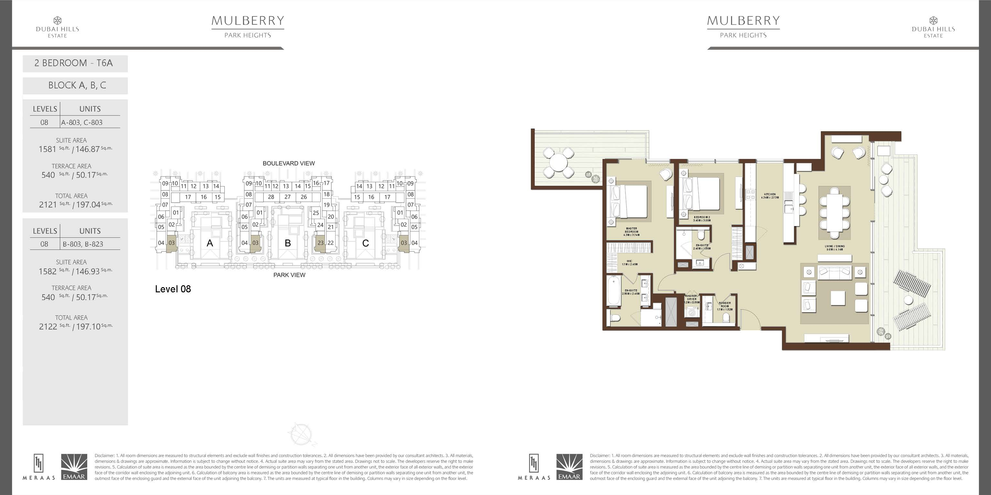
2 BEDROOM (TYP.03)

Slide 12
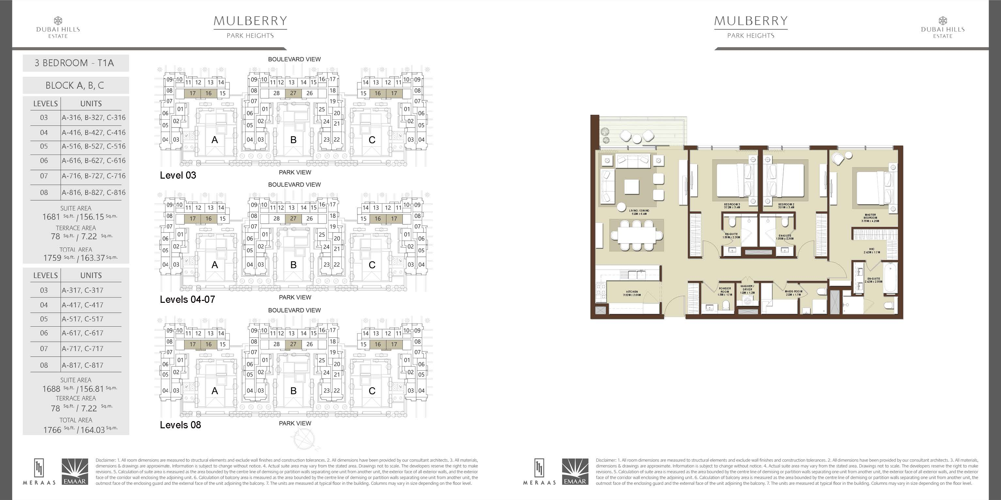
3 BEDROOM (TYP.01)

Slide 13
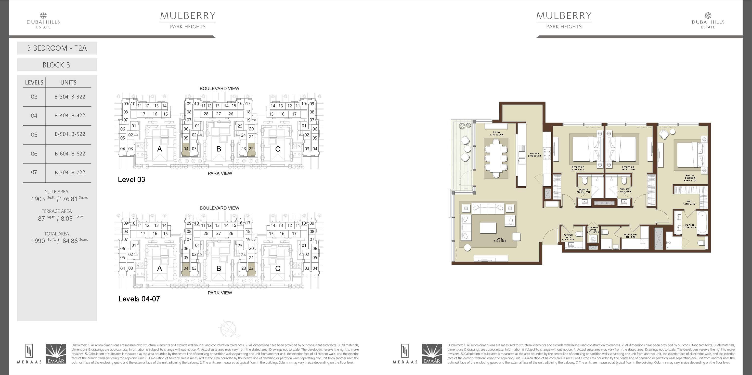
3 BEDROOM (TYP.02)

Slide 14
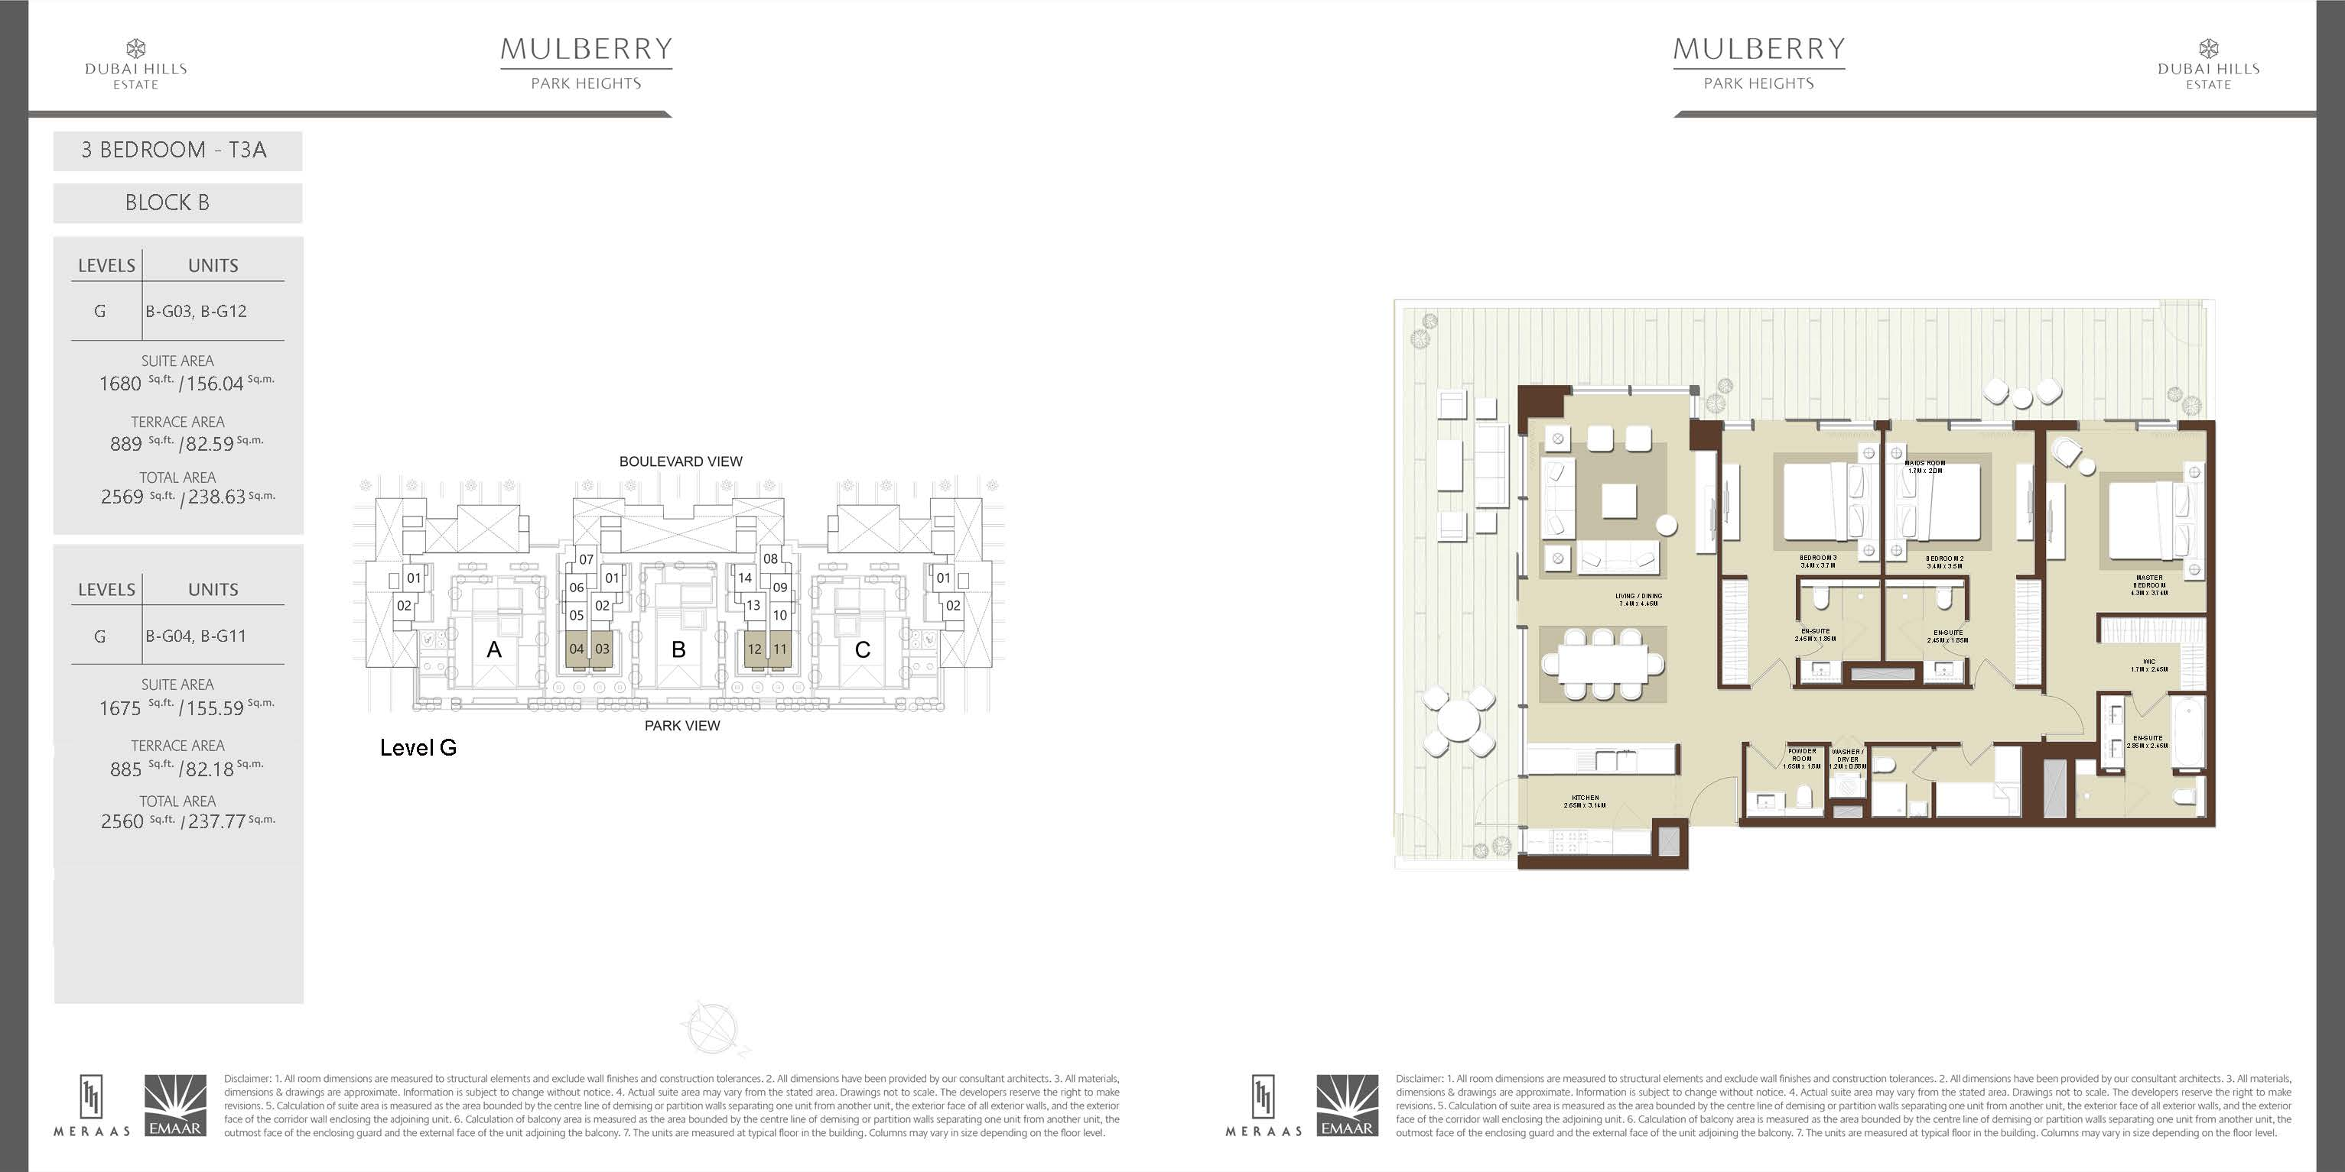
3 BEDROOM (TYP.02 G LEVEL)

Slide 15
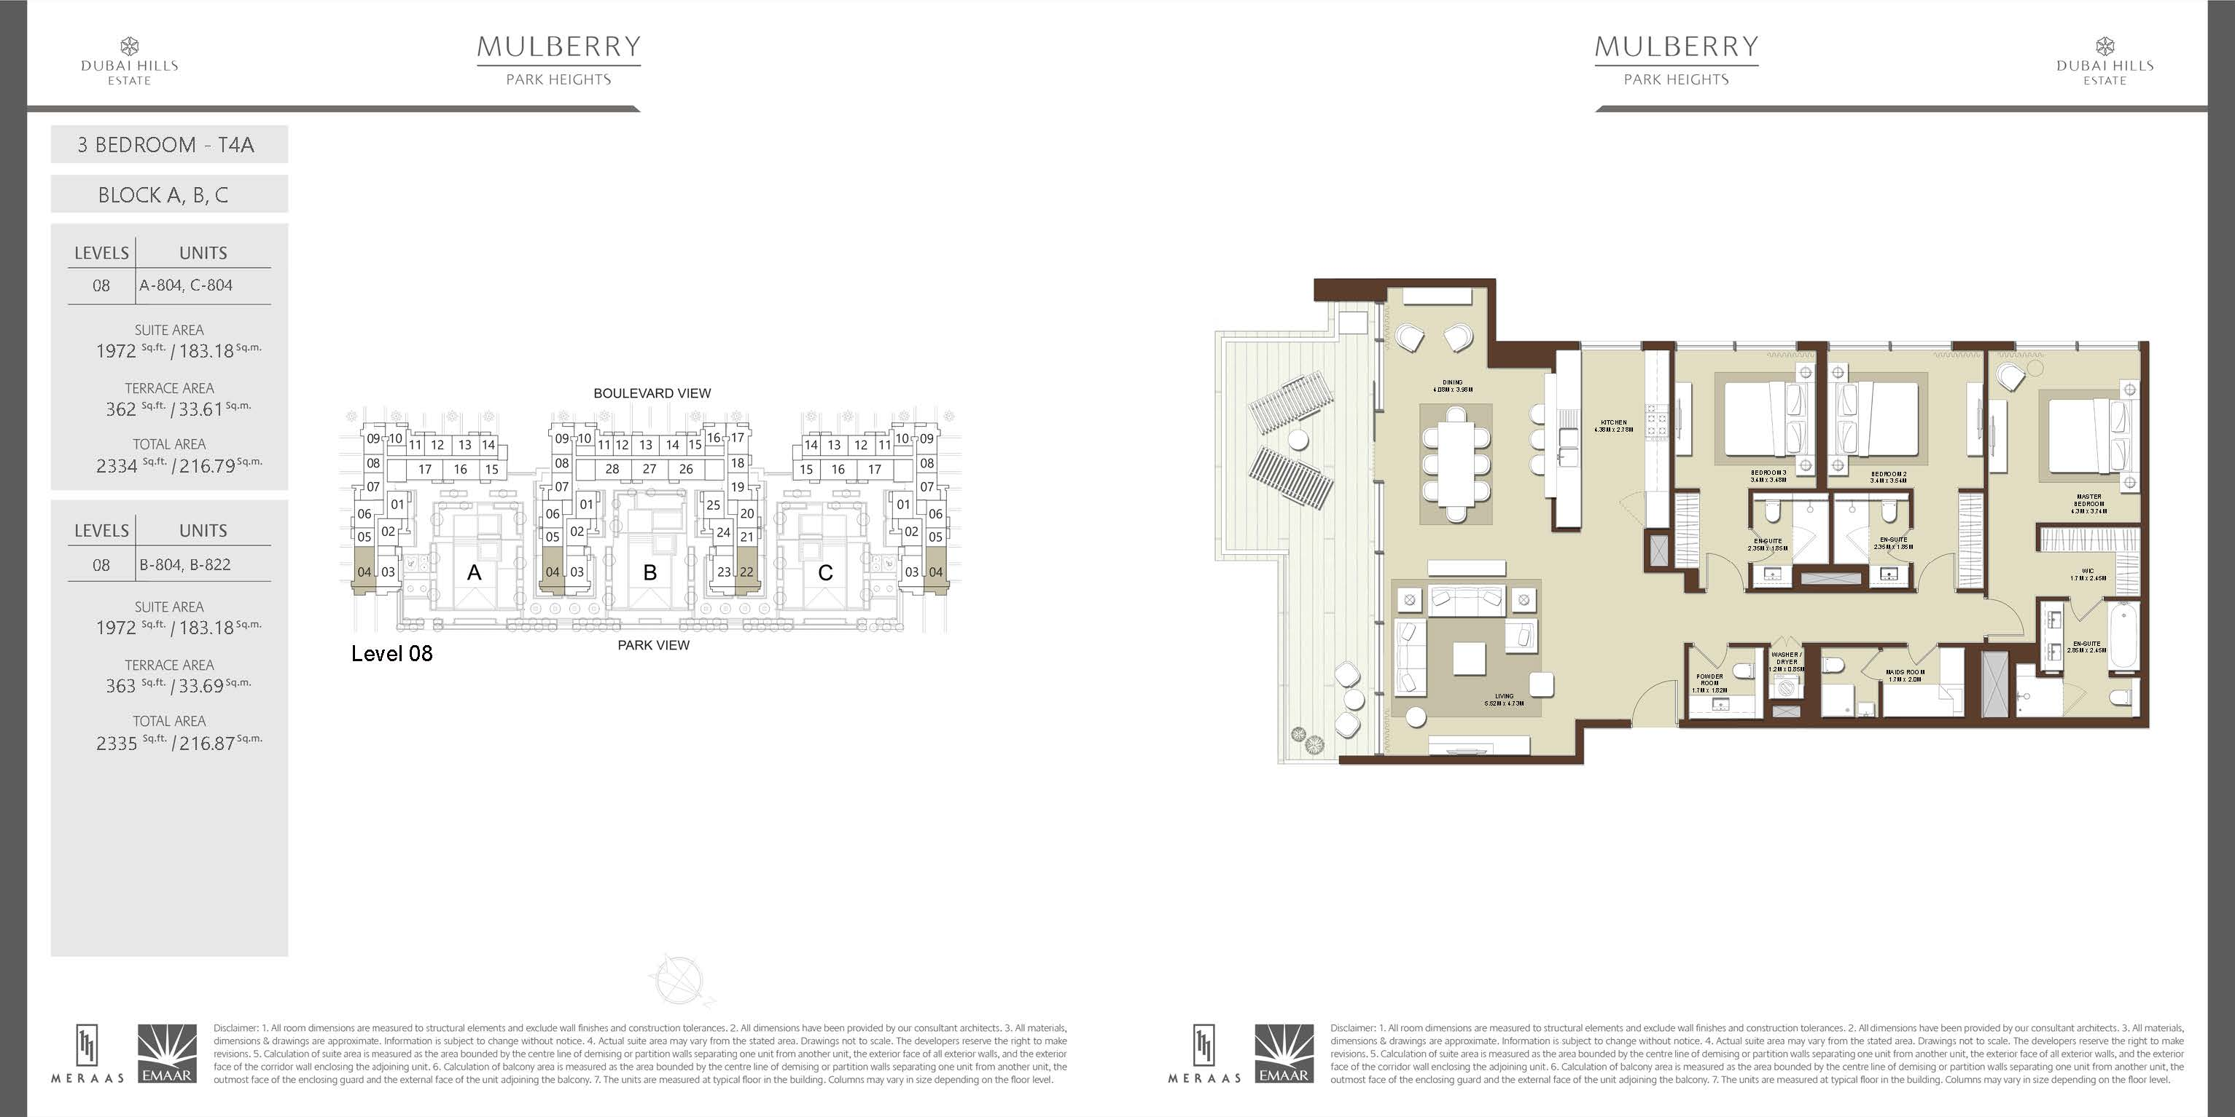
3 BEDROOM (TYP.03)

Slide 16
THANK YOU.

